Slide 1
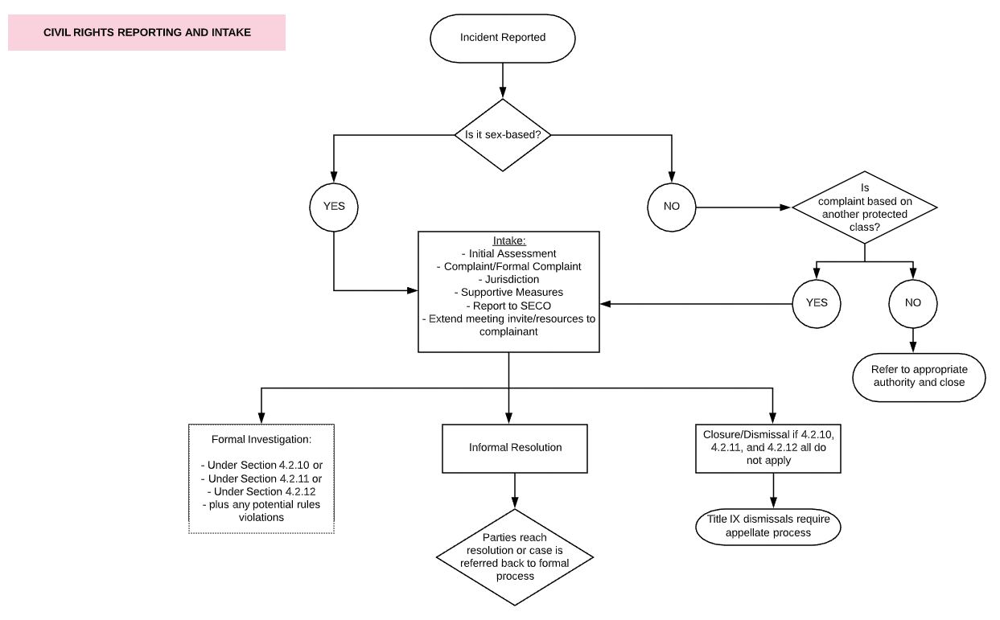
Civil Rights Adjudication Training
Notes:
STEP BY STEP

Slide 2
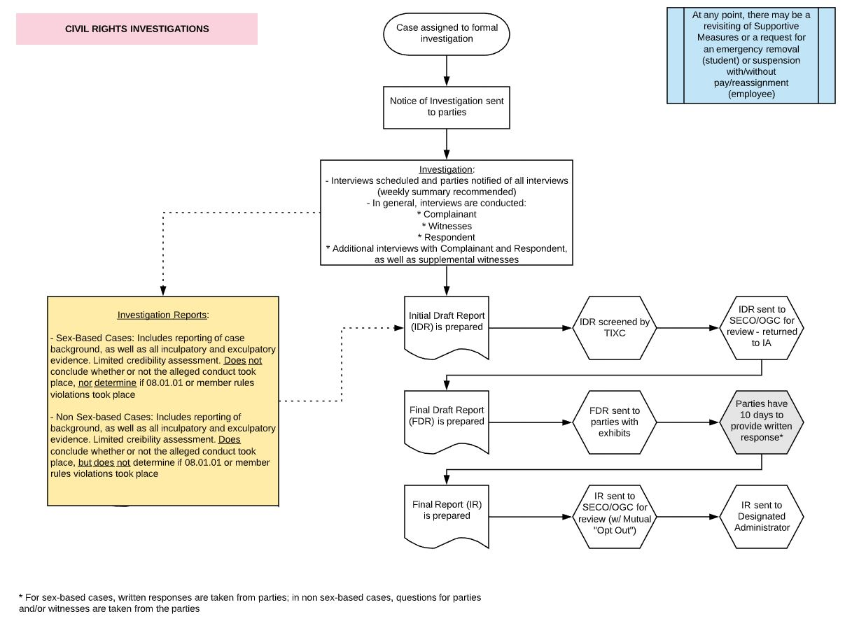
Civil Rights Adjudication Training
Notes:
STEP BY STEP

Slide 3
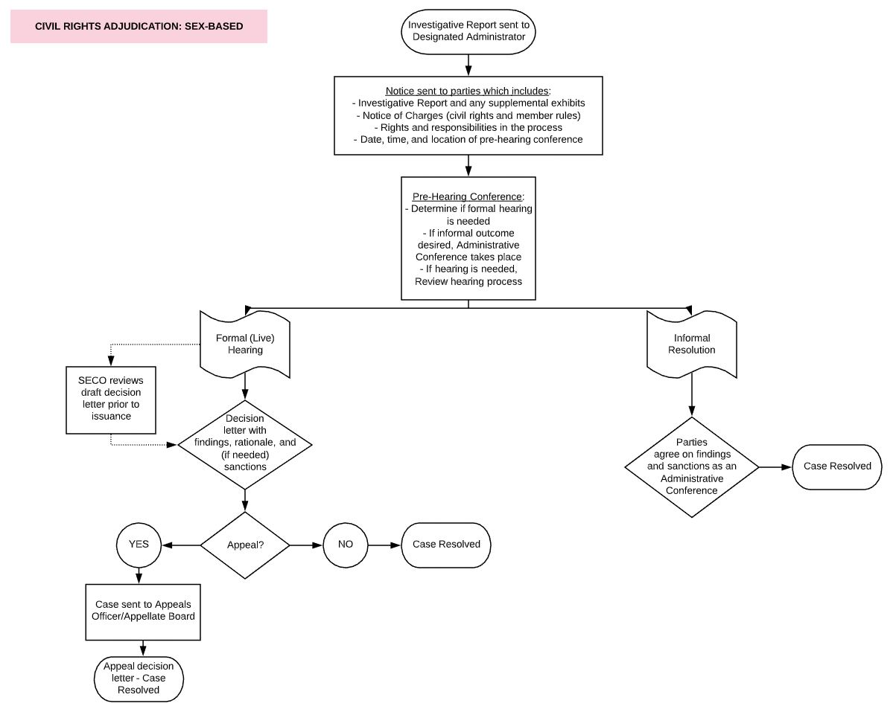
Civil Rights Adjudication Training
Notes:
STEP BY STEP

Slide 4
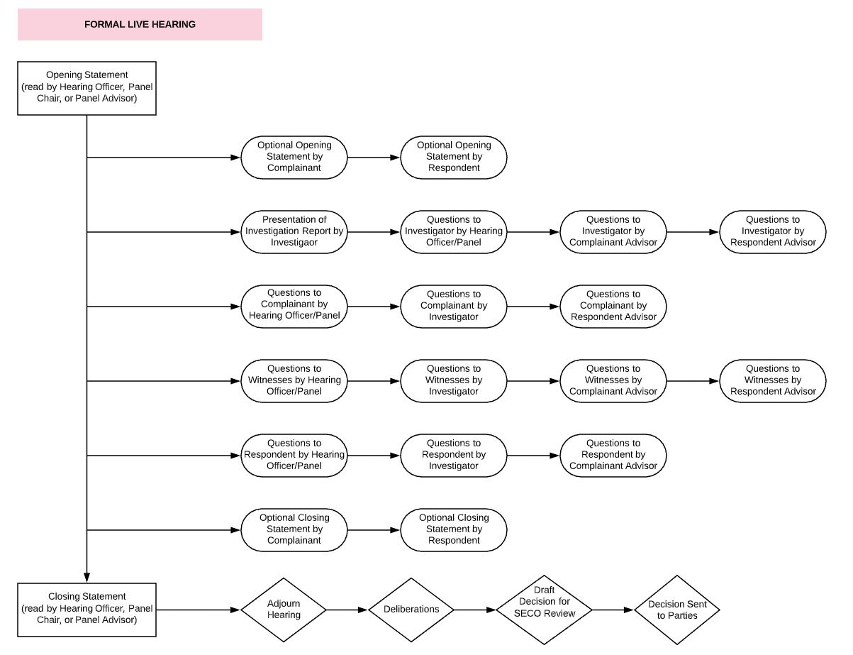
Civil Rights Adjudication Training
Notes:
TWO IMPORTANT BEST PRACTICES THAT WE STRONGLY ENCOURAGE AND WHICH WILL BE INCLUDED IN BOTH THE SCRIPT AND IN FUTURE ITERATIONS OF 08.01.01
INVESTIGATOR MUST BE INVITED TO THE HEARING AS A WIUTNESS WHO REMAINS IN THE ROOM THROUGH THE LIVE HEARING
ORDER OF QUESTIONING:
HEARING OFFICER/PANEL, THEN INVESTIGATOR, THEN OPPOSING PARTY
OUR GOAL IS TO ENGAGE IN EFFECTIVE AND THOROUIGH QUESTIONING THAT ULTIMATELY MINIMIZES THE NEED FOR RIGOROUS CROSS-EXAMINATION BY THE PARTIES
BECAUSE OF THE EMPHASIS ON CROSS EXAMINATION BY THE FEDERAL REGULATIONS, EXPECT HEARINGS TO BE LONGER; WHEN I STARTED IN THIS PROFESSION, HEARINGS INVOLVING NUMEROUS WITNESSES COULD RUN FOR AS LONG AS 6 TO 8 HOURS; AFTER WE STREAMLINED THE PROCESS FOLLOWING THE 2011 FEDERAL GUIDANCE, I SERVED OVER HEARINGS THAT WOULD GENERALLY LAST FROM 1 TO 2 HOURS.

Slide 5
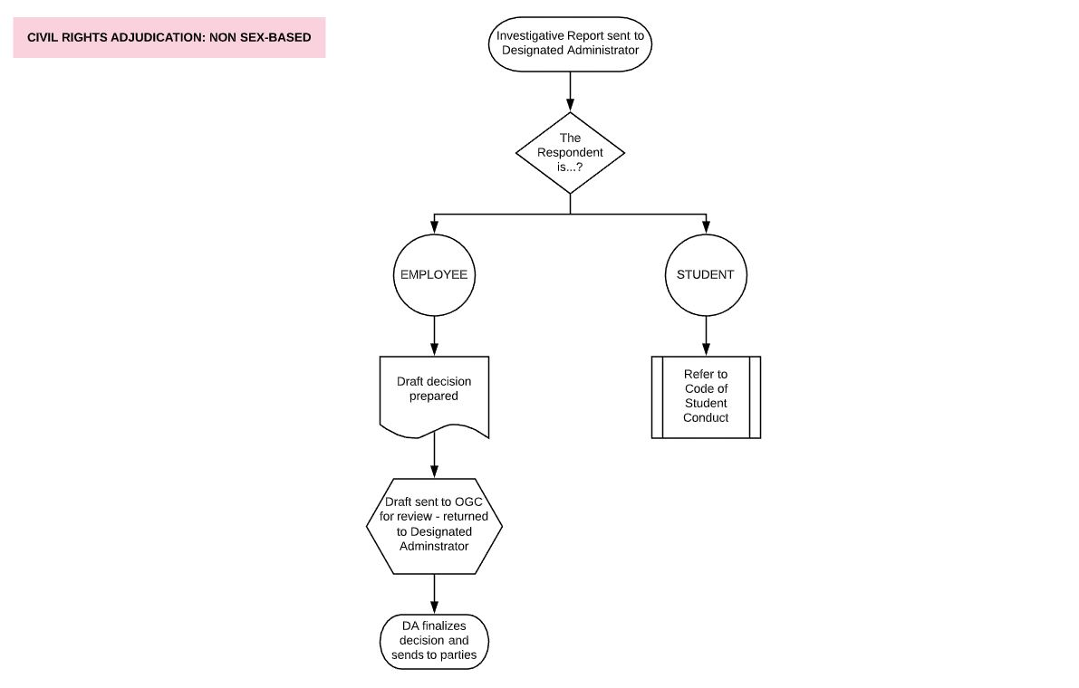
Civil Rights Adjudication Training
Notes:
STEP BY STEP

Slide 6
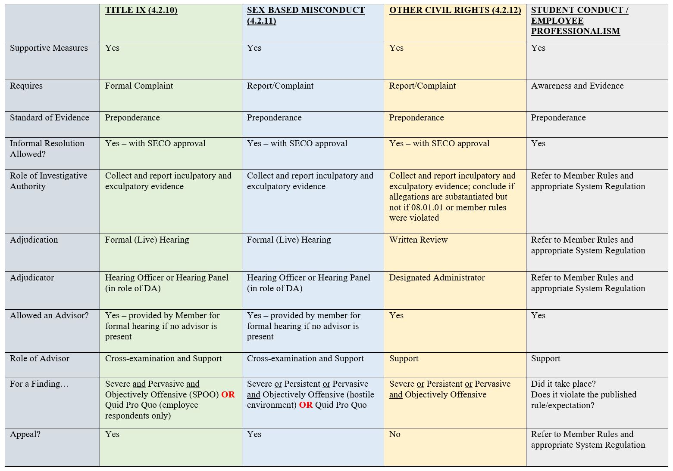
Civil Rights Adjudication Training
Notes:
NOTE – YOU MAY BE ASKED TO MAKE DECISIONS INVOLVING BOTH SYSTEM REGULATION 08.01.01 AND MEMBER RULES. IT IS CRITICAL THAT YOU USE THE APPROPRIATE STANDARD FOR EACH, AND THAT YOUR FINDING OF FACT INCLUDES THE STANDARD APPROPRIATE TO THE ALLEGATION BEING ADDRESSED.

